Slide 1
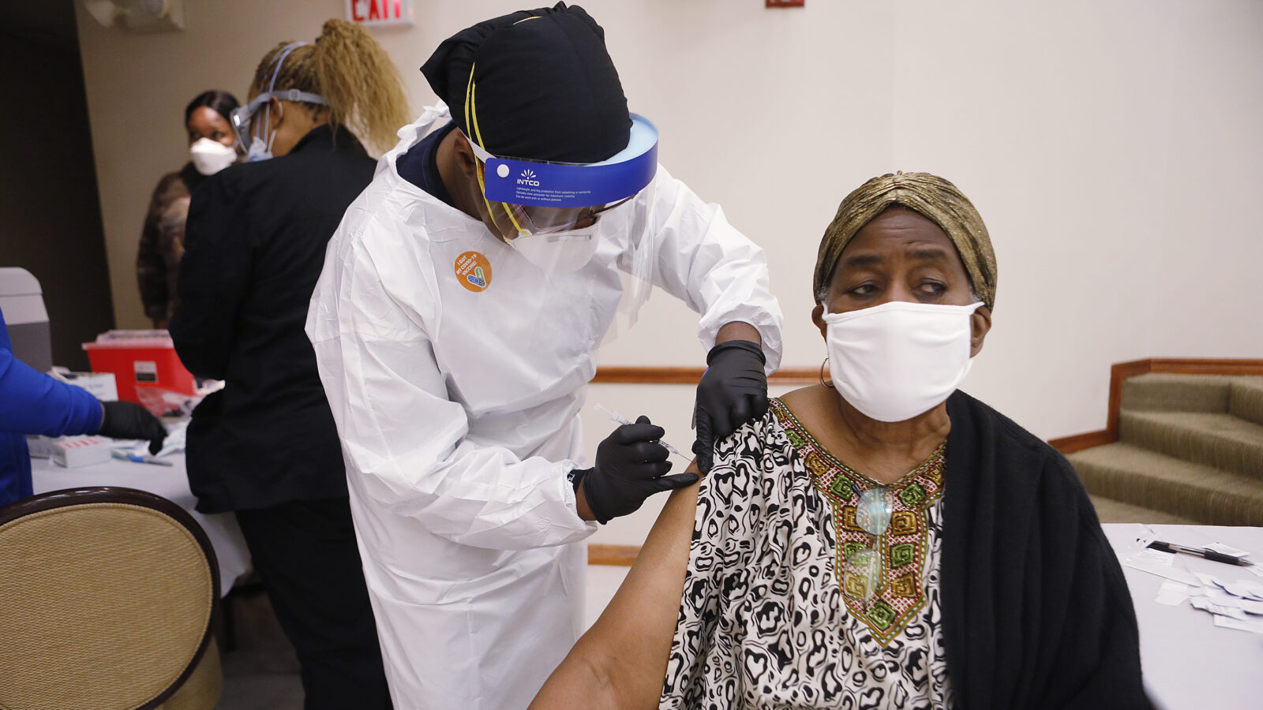

COVID-19 & THE BLACK COMMUNITY

Slide 2
COVID-19 Data in the Black Community
According to the Kaiser Family Foundation, Black Americans are more likely to become severely ill or die due to complications of COVID-19 than other populations. In fact, Black individuals account for 15% of COVID-19 deaths in the U.S., though they make up only 12% of the overall population, and are nearly three times as likely to be hospitalized due to COVID-19 as white people. (Dec. 2021)
As of Jan. 10, 2022, 54% of Black individuals across a majority of states in the U.S. had received at least one vaccine dose – a lower rate than among white, Hispanic and Asian populations, according to an analysis by the Kaiser Family Foundation. (Jan. 2022)
Sources: COVID-19 Vaccine Hesitancy Among Black Americans | Sharp Health News
Notes:
Sources: Black Americans Beat Vaccine Hesitancy Faster Than Whites | Healthiest Communities Health News
COVID-19 Vaccine Hesitancy Among Black Americans | Sharp Health News

Slide 3
Webinar Outline
History of Medical Mistrust in the Black Community
Black Pioneers in Vaccine Development
Addressing Vaccine Hesitancy in the Black Community
Is the COVID-19 Vaccine Safe?
Why Get Vaccinated?
The Upside: Black Americans are Changing the Narrative

Slide 4
History of Medical Mistrust in the Black Community

Slide 5
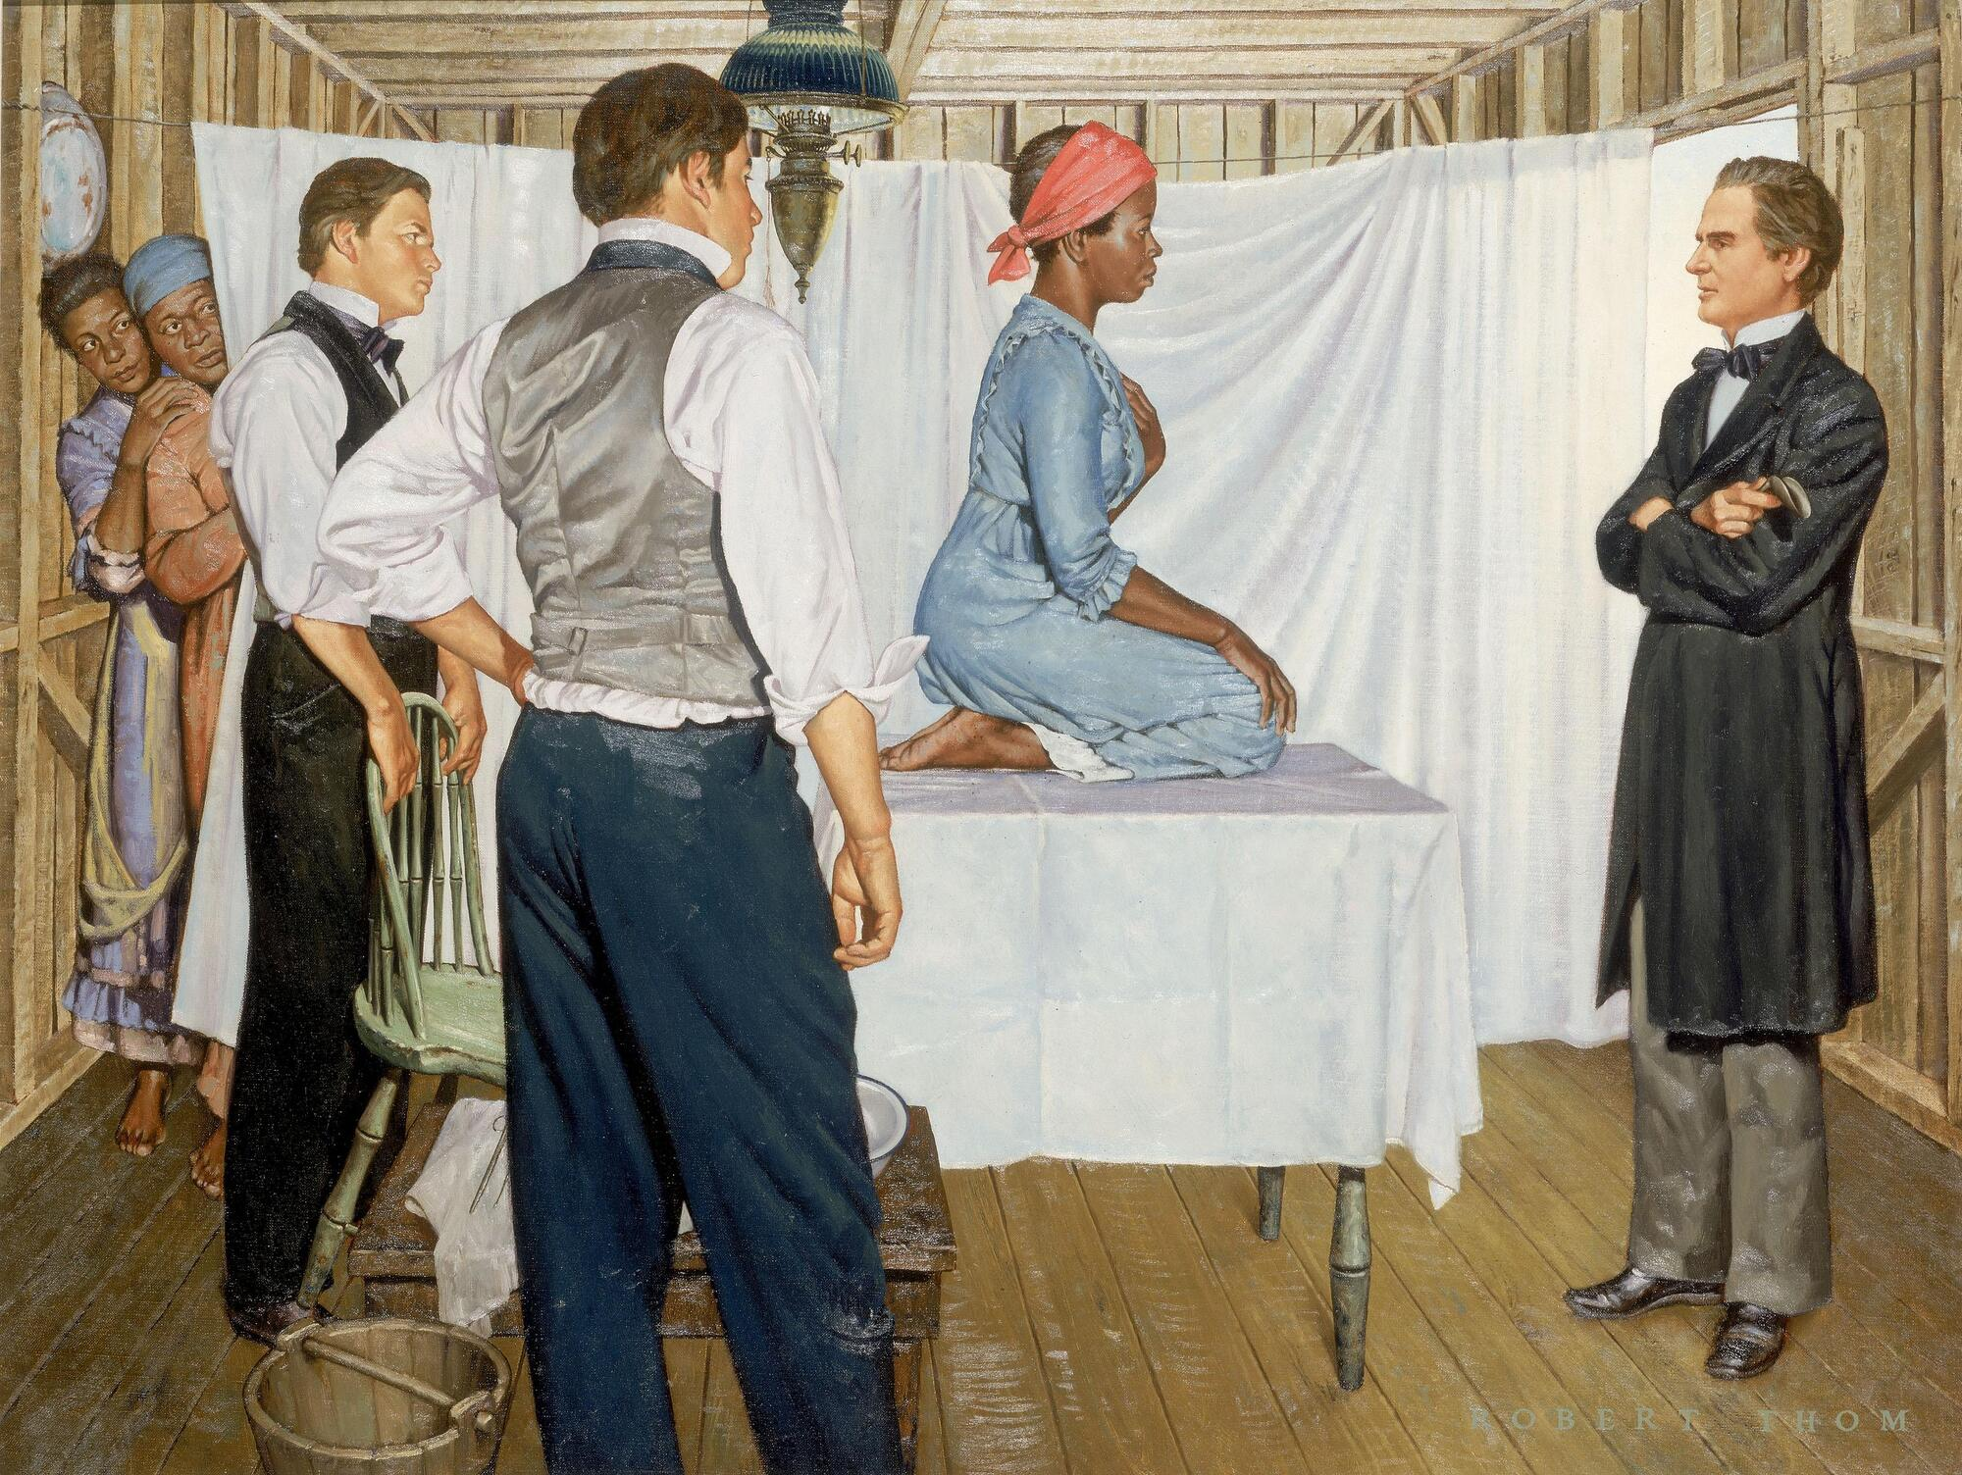
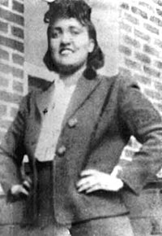
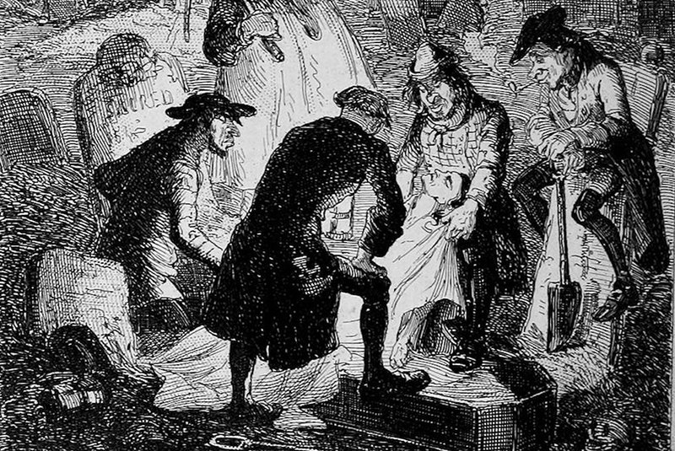
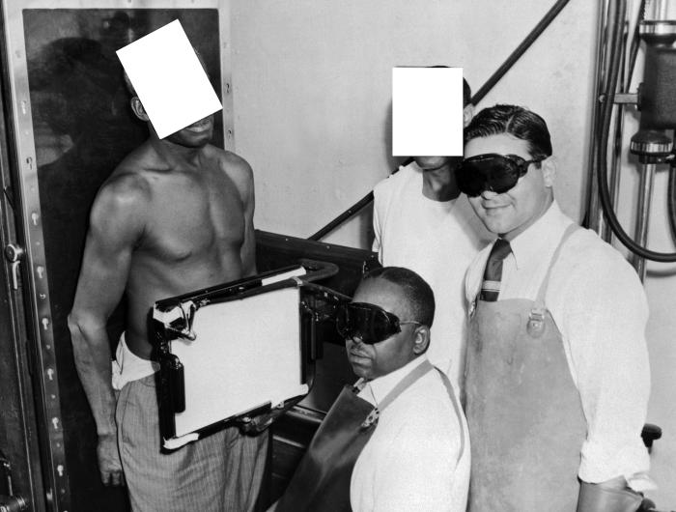
History of Medical Mistrust in the Black Community
Tuskegee Experiment: The Infamous Syphilis Study
The Tuskegee Study of Untreated Syphilis in the Negro Male was an observational study on African-American males in Tuskegee, Alabama between 1932 and 1972. The U. S. Public Health Service ran this study on more than 300 people without notifying the participants about their disease nor treating them even after the introduction of penicillin.
Medical Colleges Stole Freshly-Buried Black Corpses in the 1830s for Study
In the 19th century, students at American medical schools stole the corpses of recently-buried African Americans to be used for dissection.
1845
1951
1830’s
1932 - 1972
J. Marion Sims Begins Experimenting on Enslaved Black Women
After 30 operations on one woman, a 17-year-old enslaved woman named Anarcha who had had a very traumatic labor and delivery, he finally “perfected” his method—after four years of experimentation without anesthesia. Afterward, he began to practice on white women, using anesthesia, which was new to the medical field at the time
Henrietta Lacks’ Cancer Cells are Stolen by Johns Hopkins Hospital
In 1951, doctors took a tissue sample from a poor, dying black woman that was given to researchers without her knowledge or permission. The HeLa cells, named for the patient’s first and last name, acted differently than other cells in the lab — they were hardier and replicated at an amazing rate. They also didn’t die.

Slide 6
Black Pioneers in Vaccine Development

Slide 7
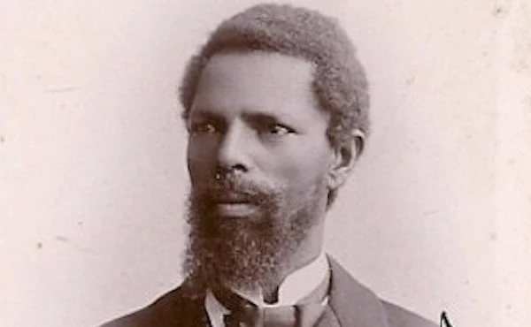
How an Enslaved African Man Paved the Way for Vaccines
“An enslaved African, Onesimus helped to save hundreds of Bostonians from smallpox in 1721. Left out of the history books, he taught others about the practice of inoculation, which was common in Africa and Asia long before vaccines were established. He explained that taking the pus from an infected individual’s pustule and inserting it into the broken skin of a healthy person, led to that person being immune from future infections—a true public health breakthrough in containing a ravenous infectious disease.”
Sources: Who Is Onesimus? | ASTHO ; How an Enslaved African Man in Boston Helped Save Generations from Smallpox - HISTORY
Notes:
Source: How an Enslaved African Man in Boston Helped Save Generations from Smallpox - HISTORY
Who Is Onesimus? | ASTHO
Smallpox vaccines.

Slide 8
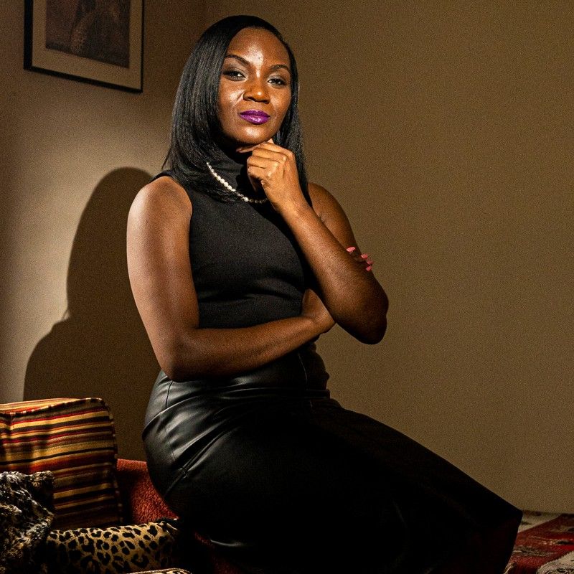
Dr. Kizzmekia Corbett: Lead Developer of the Moderna mRNA COVID-19 Vaccine
Dr. Kizzmekia S. Corbett led the National Institutes of Health team that developed the Moderna COVID-19 vaccine. She is currently an assistant professor at Harvard University’s T.H. Chan School of Public Health and was recently named one of Time magazine’s 2021 Heroes of the Year. Dr. Corbett uses her viral immunology expertise to propel novel vaccine development for pandemic preparedness. In all, she has over 15 years of experience studying dengue virus, respiratory syncytial virus, influenza virus, and coronaviruses, garnering several prestigious awards, such as the Benjamin Franklin Next Gen Award and the Salzman Memorial Award in Virology. Combining her research goals with her knack for mentorship, Dr. Corbett invests much of her time in underserved communities as an advocator of STEM education and vaccine awareness.
She received a B.S. in Biological Sciences, with a secondary major in Sociology, in 2008 from the University of Maryland–Baltimore County, where she was a Meyerhoff Scholar and an NIH undergraduate scholar. She then enrolled at University of North Carolina at Chapel Hill, where she obtained her Ph.D. in Microbiology and Immunology in 2014.
Sources: Coronavirus: Vaccines & Variants with Kizzmekia S. Corbett, PhD - The Washington Post ; Kizzmekia S. Corbett, Ph.D. | ASM.org
Notes:
Sources: Coronavirus: Vaccines & Variants with Kizzmekia S. Corbett, PhD - The Washington Post
Kizzmekia S. Corbett, Ph.D. | ASM.org

Slide 9
Addressing Vaccine Hesitancy in the Black Community

Slide 10
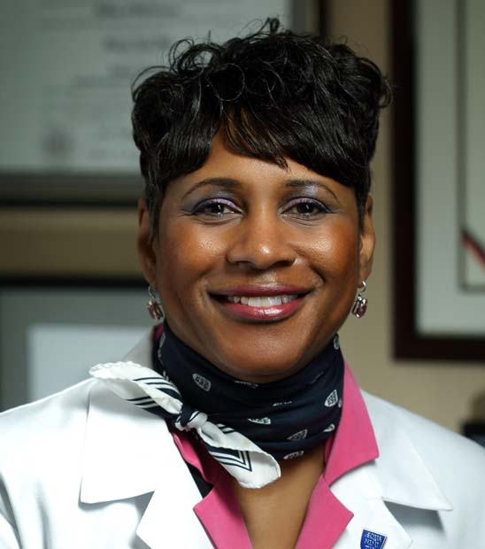
Is the Vaccine Safe?
Were the COVID-19 vaccines developed too fast to be safe?
  “No,” Golden says. “Although people are understandably concerned about how quickly these vaccines were brought to market, and despite the name ‘Warp Speed,’ we know that there were large trials that were conducted correctly. They did not cut corners. Read more about vaccine safety.
Does the COVID-19 vaccine change my DNA?
  “No,” Golden says. “The vaccines do not affect the nucleus of the cells, where the DNA resides. The technologies are not new.
  “Dr. Kizzmekia Corbett helped developed the vaccines,” Golden adds, referring to the African American viral immunologist at the National Institutes of Health [now an assistant professor at Harvard]. She adds that other leaders from communities of color volunteered to take part in the tests, noting, “Dr. Freeman Hrabowski III, president of the University of Maryland, Baltimore County, was a clinical trial participant.”
Sources: COVID-19 Vaccines and People of Color | Johns Hopkins Medicine
Sherita Hill Golden, M.D., M.H.S., Vice president and chief diversity officer at Johns Hopkins Medicine

Slide 11
Is the COVID-19 Vaccine Safe?

Slide 12
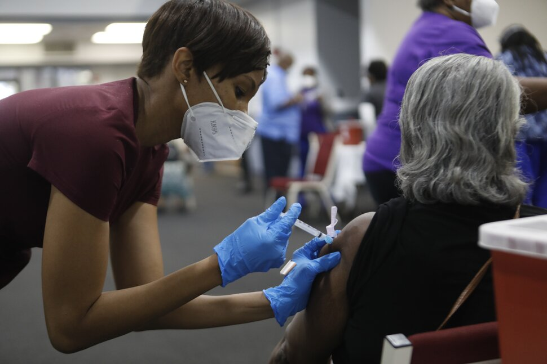
Hundreds of Millions of People Have Safely Received a COVID-19 Vaccine
More than 559 million doses of COVID-19 vaccine had been given in the United States from December 14, 2020, through March 28, 2022. To view the current total number of COVID-19 vaccinations that have been administered in the United States, please visit the CDC COVID Data Tracker.
COVID-19 vaccines are safe and effective. COVID-19 vaccines were evaluated in tens of thousands of participants in clinical trials. The vaccines met the Food and Drug Administration’s (FDA’s) rigorous scientific standards for safety, effectiveness, and manufacturing quality needed to support emergency use authorization (EUA). Learn more about EUAs in this video.external icon
The Pfizer-BioNTech, Moderna, and Johnson & Johnson/Janssen COVID-19 vaccines will continue to undergo the most intensive safety monitoring in US history. This monitoring includes using both established and new safety monitoring systems to make sure that COVID-19 vaccines are safe.
Sources: Safety of COVID-19 Vaccines | CDC.
Notes:
Sources: Safety of COVID-19 Vaccines | CDC

Slide 13
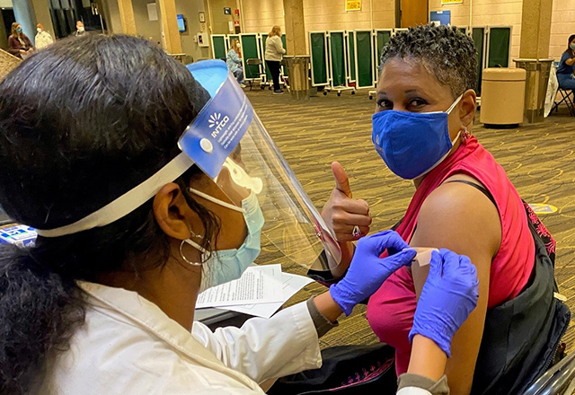
Common Side Effects
After COVID-19 vaccination, some people may feel ill, with symptoms like fever or tiredness for a day or two after receiving the vaccine. These symptoms are normal and are signs that the body is building immunity. Some people have no side effects. Others have reported common side effects after COVID-19 vaccination, such as:
Swelling, redness, and pain at the injection site
Fever
Headache
Tiredness
Muscle pain
Chills
Nausea
Serious Safety Problems Are Rare

Slide 14
Why Get Vaccinated?

Slide 15
Why Get Vaccinated?
Getting sick with COVID-19 can have serious consequences.
  Getting sick with COVID-19 can cause severe illness or death, even in children, and we can’t reliably predict who will have mild or severe illness.
  You may have long-term health issues after COVID-19 infection. Even people who do not have symptoms when they are initially infected can have these ongoing health problems.
  People who are sick with COVID-19 may spread COVID-19 to others including friends and family who are not eligible for vaccination and people at increased risk for severe illness from COVID-19
COVID-19 vaccines are effective
  COVID 19-vaccines are effective and can lower your risk of getting and spreading the virus that causes COVID-19. COVID-19 vaccines also help prevent serious illness and death in children and adults even if they do get COVID-19.
COVID-19 vaccination is a safer & more reliable way to build protection
  The level of protection people get from having COVID-19 (sometimes called natural immunity) may vary depending on how mild or severe their illness was, the time since their infection, and their age; and there is still not an antibody test available that can reliably determine if a person is protected from further infection.
  All COVID-19 vaccines currently available in the United States are effective at preventing COVID-19. Staying up to date with COVID-19 vaccination gives most people a high level of protection against COVID-19.
Sources: Benefits of Getting a COVID-19 Vaccine | CDC
Notes:
Sources: Benefits of Getting a COVID-19 Vaccine | CDC
Benefits of Getting a COVID-19 Vaccine | CDC

Slide 16
The Upside: Black Americans are Changing the Narrative

Slide 17
Study: Black Americans Beat Back Vaccine Hesitancy Faster Than Whites
“Early on in the pandemic, though approximately 1 in 5 U.S. counties were disproportionately Black, they’d accounted for 52% of COVID-19 diagnoses and nearly 60% of COVID-related deaths nationally.”
“Black individuals have overcome hesitation about getting vaccinated against COVID-19 more quickly than whites, new research indicates, raising the possibility that access barriers may be contributing more to the racial disparity in vaccination rates than mistrust of the medical establishment.”
“An analysis of survey results recently published in JAMA Network Open found Black individuals on average were slightly less intent on getting vaccinated than white individuals when COVID-19 vaccines were first introduced in December 2020. But views about the necessity of the vaccine became more positive among Black individuals at a more rapid pace in later months, according to the study, appearing to fuel an increase in willingness among participants to get vaccinated.”
Source: Black Americans Beat Vaccine Hesitancy Faster Than Whites | Healthiest Communities Health News
Notes:
Source: Black Americans Beat Vaccine Hesitancy Faster Than Whites | Healthiest Communities Health News

Slide 18
Bibliography
African introduced practice of immunization against smallpox | Health | insightnews.com
Myths and Facts about COVID-19 Vaccines | CDC
Is the COVID-19 Vaccine Safe? | Johns Hopkins Medicine
Is the COVID-19 Vaccine Safe? | Johns Hopkins Medicine
Black Doctors COVID-19 Consortium
This COVID-vaccine designer is tackling vaccine hesitancy — in churches and on Twitter

Slide 19
Bibliography (continued)
The COVID Racial Data Tracker
COVID-19 Cases and Deaths by Race/Ethnicity: Current Data and Changes Over Time | KFF
The 'Father of Modern Gynecology' Performed Shocking Experiments on Enslaved Women - HISTORY
.In Need of Cadavers, 19th-Century Medical Students Raided Baltimore's Graves | History| Smithsonian Magazine
The Paris Review - Night Doctors: Why Early Medical Schools Plundered the Graves of African Americans
Safety of COVID-19 Vaccines | CDC
Black Americans Beat Vaccine Hesitancy Faster Than Whites | Healthiest Communities Health News
New York removes J. Marion Sims statue of surgeon who experimented on enslaved women - Vox

Slide 20
Bibliography (continued)
What Contributes to COVID-19 Vaccine Hesitancy in Black Communities, and How Can It Be Addressed? | RAND
COVID-19 Vaccines and People of Color | Johns Hopkins Medicine
https://www.sharp.com/health-news/ensuring-black-americans-receive-covid-19-vaccines.cfm
Dr. Kizzmekia Corbett, who worked on COVID vaccine,​ on changing the game in science: "It is an honor to be inspirational" - CBS News
Kizzmekia S. Corbett, Life Science (2021) | The Franklin Institute
Coronavirus: Vaccines & Variants with Kizzmekia S. Corbett, PhD - The Washington Post
Kizzmekia S Corbett | Academic Profile | Harvard TH Chan School of Public Health

Slide 21
Bibliography (continued)
New York removes J. Marion Sims statue of surgeon who experimented on enslaved women - Vox
African-American Bodies Stolen from Graves: The Dark Past of Old Medical College of Georgia | Black Then
History of Smallpox
Cotton Mather and the Salem Witch Trials - The History Junkie
https://adc.bmj.com/content/88/10/841
The immortal cells of Henrietta Lacks - Robin Bulleri

